Slide 1
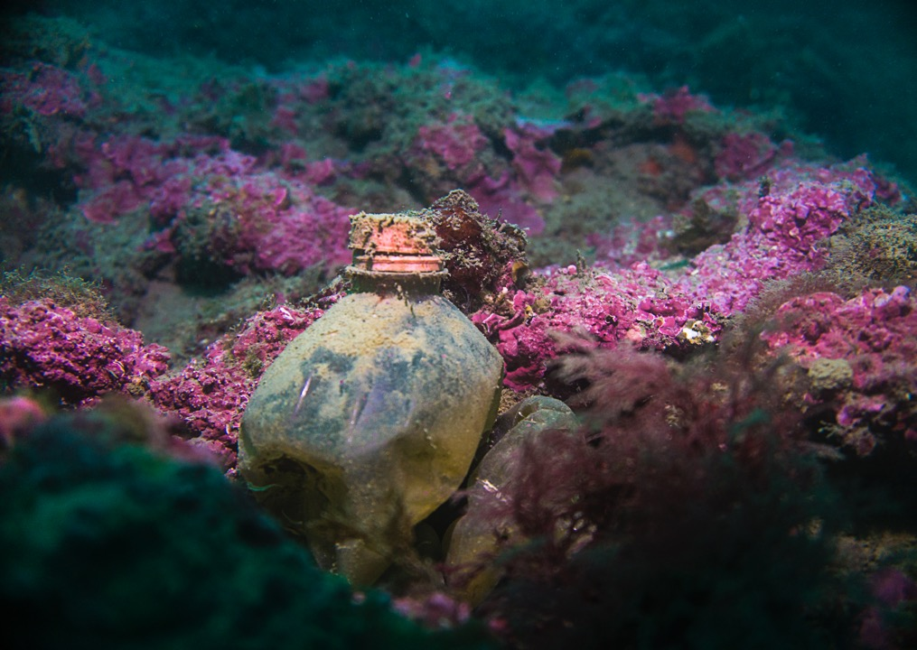
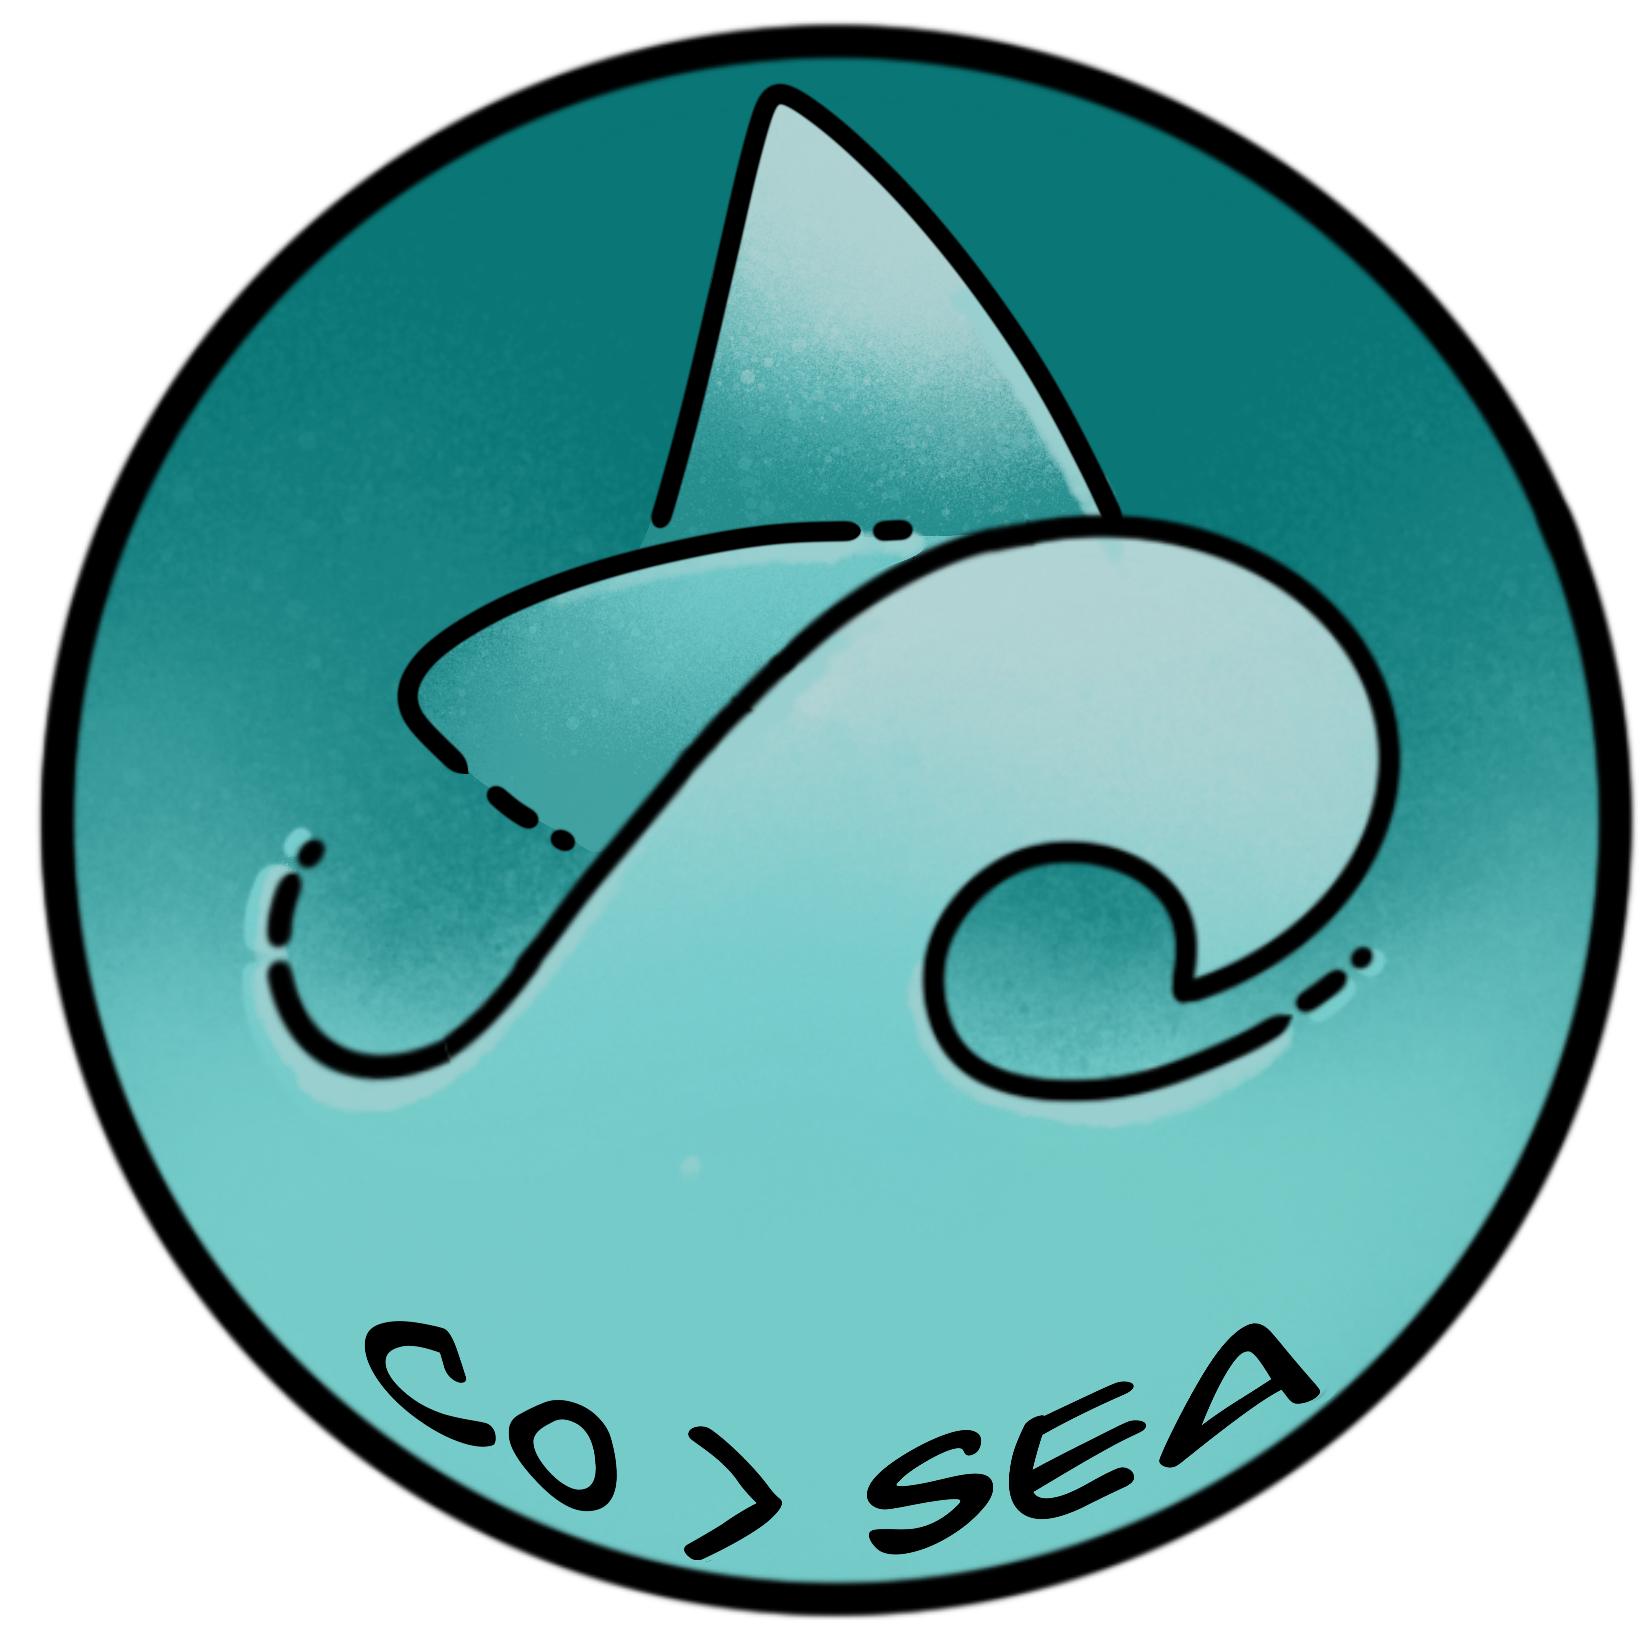
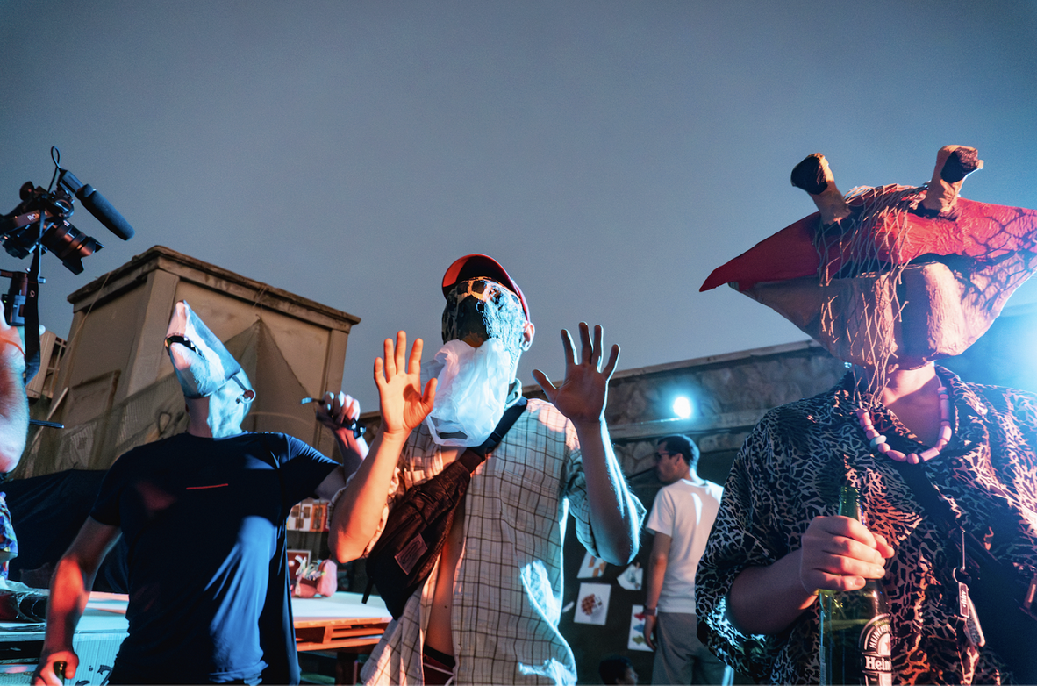
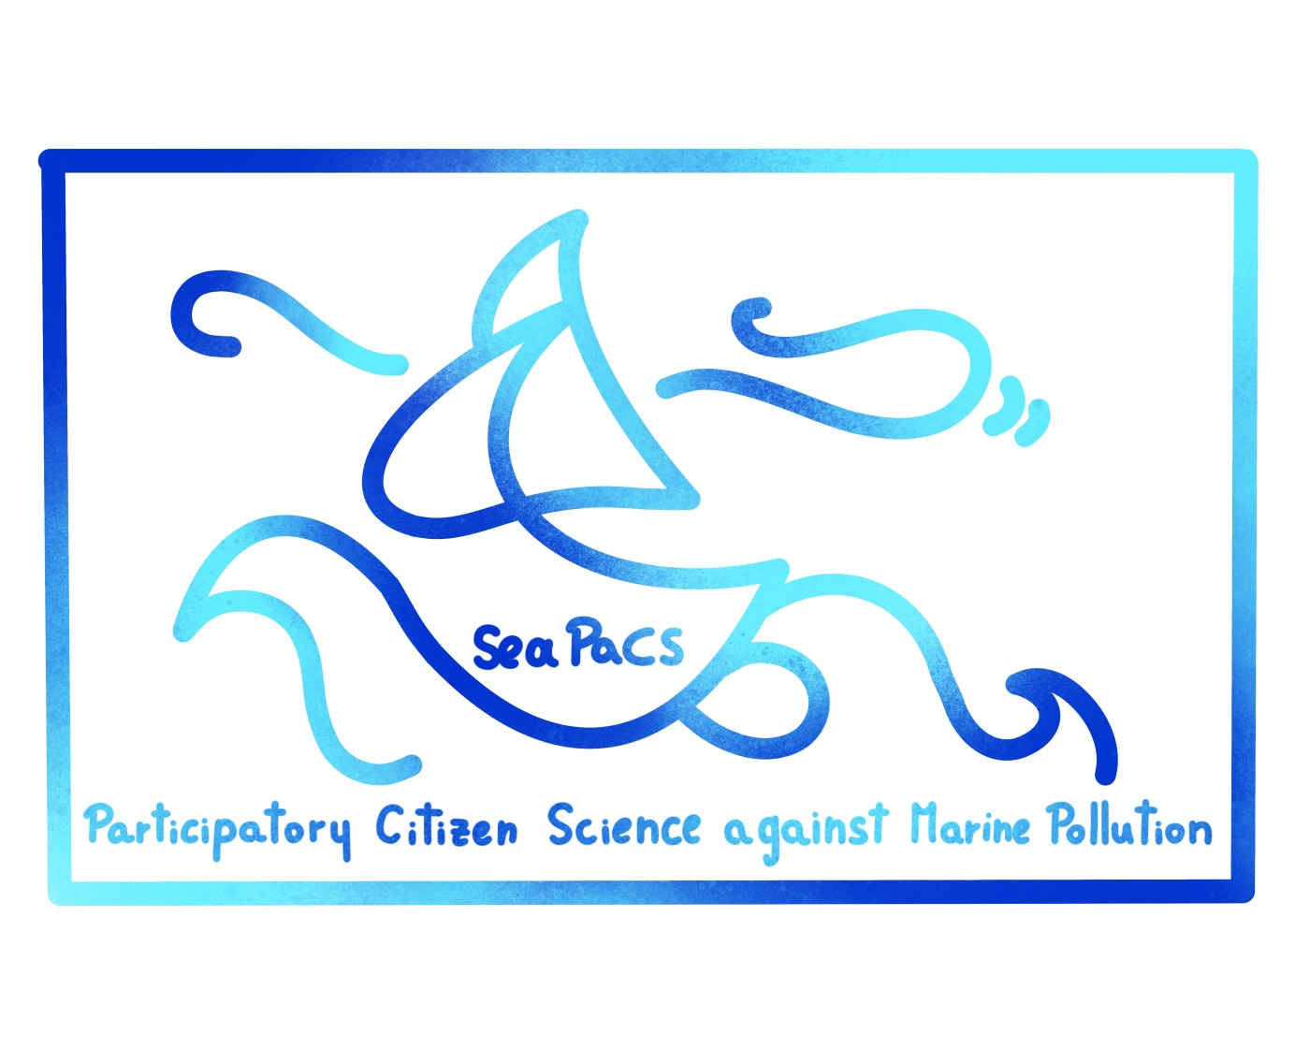
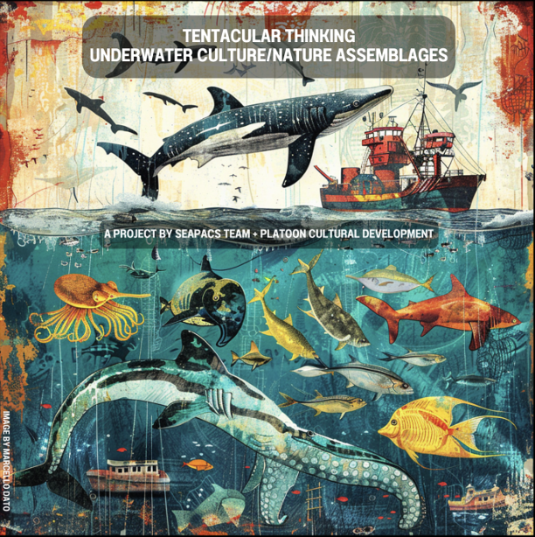
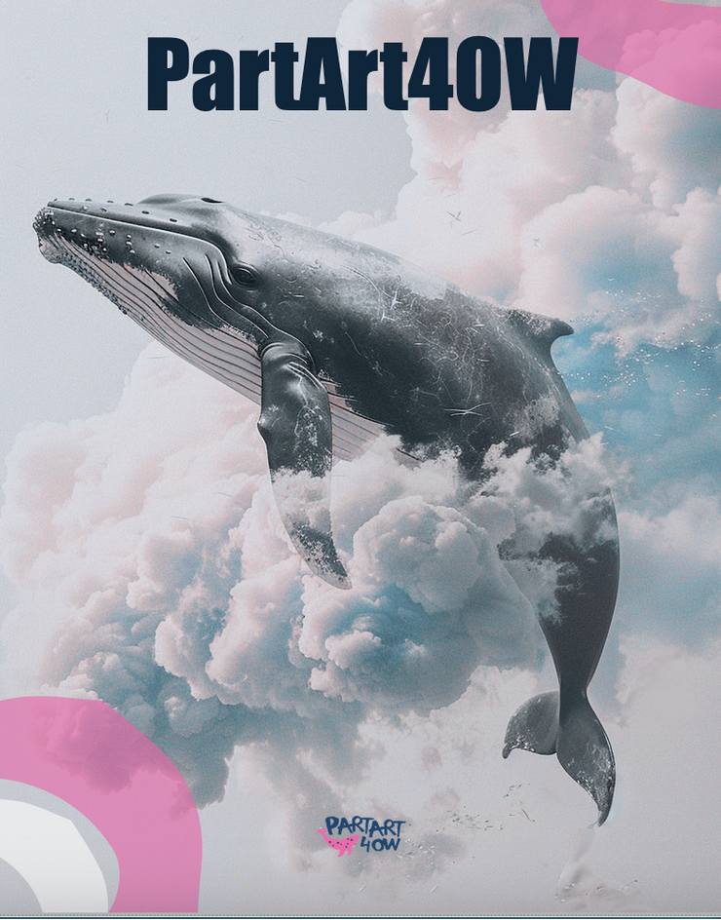
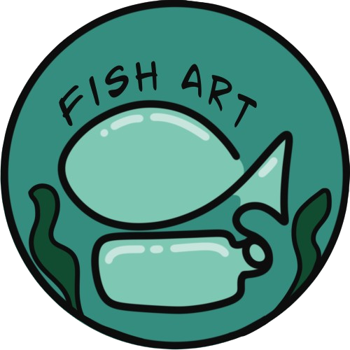
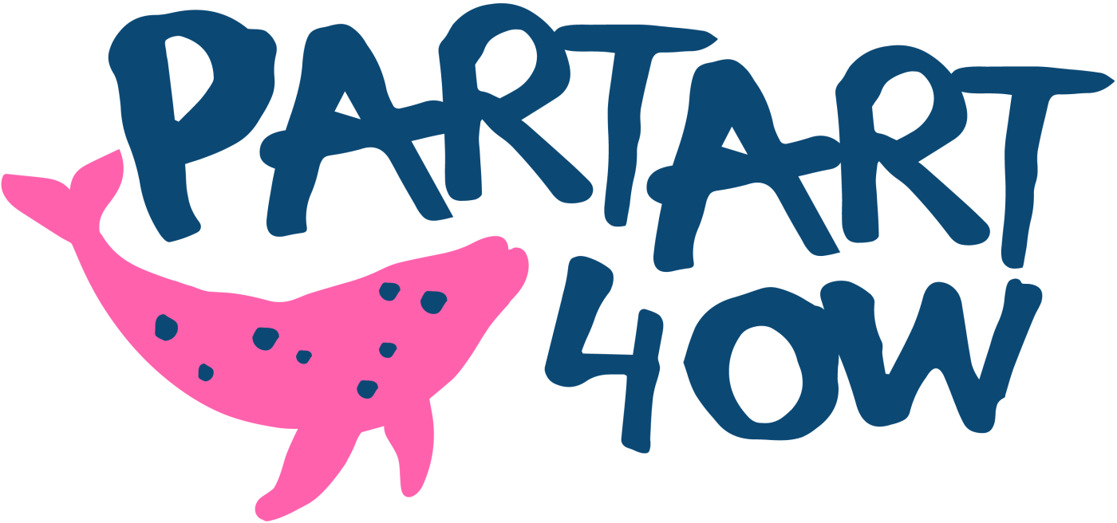
“PartArt4OW. Participatory Art for Society engagement with Ocean and Water”, www.partart4ow.eu)
Participatory action-research to tighten Society&Ocean relationship
SeaPaCS Participatory Citizen Science against Marine Pollution” (HorizonEU2023) https://crowdusg.net/seapacs/):,
FishArt. Participatory Art for the Ocean at Anzio’s harbour” (NEB EU2024) https://crowdusg.net/fishart/):
“Tentacular Thinking” (CultureMovesEurope 2024, https://crowdusg.net/tentacular-thinking/)

