Slide 1
Sustainable cities and digital participation
Analysing and modelling digital social innovation processes in the governance of urban sustainability in Turin and Brussels
Samantha Cenere, Università degli Studi di Torino, ESOMAS Department
Chiara Certomà, Università degli Studi di Torino, ESOMAS Department

Slide 2
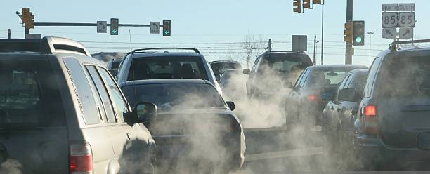
The context
Increasing unsustainability of urban living
Progressive loss of community cohesion and weakening of
democratic institutions
Need for participatory approaches to tackle urban sustainability
Digital technologies as powerful tools for participatory modes of governance
Research objective: to investigate how heterogeneous actors leverage on digital technologies in order to co-create knowledge and to collaboratively trace new paths for tackling sustainability issues at the urban level

Slide 3
The first phase of research:
Exploring Digital Social Innovation (DSI)
Literature review of: 1) reports, deliverables, and websites related to EU projects on DSI; 2) academic works explicitly referring to DSI in urban contexts; 3) academic works that, without mobilising the concept of DSI, yet discuss practices and initiatives that may fall within the boundaries of social innovation through/on the digital dimension of collective life.
DSI: “A type of social and collaborative innovation in which innovators, users and communities collaborate using digital technologies to co-create knowledge and solutions for a wide range of social needs” (Bria et al., 2014)
The role of technology: not a mere support but a core element; reconfiguration of socio-technical systems
Great potential to reconfigure urban governance: increased participation of citizens in collaborative processes

Slide 4
The first phase of research:
Scoping the heterogeneity of urban DSI-related initiatives
Difficulty: not univocal understanding of DSI and heterogeneity of initiatives
Reason: “different communities of actors, geographical ties, multi-layered practices, and culturally specific contexts from which they emerge” (Certomà, 2021: 70)
The urban dimension. Innovative socio-technical systems analogous to DSI: urban digital platforms (Chiappini & De Vries 2022), communal sharing platforms (Santala & McGuirk 2022), technological sovereignty (Balaguer & Rasillo 2021; Lynch 2020), non-corporate platforms (Mello Rose 2022)

Slide 5
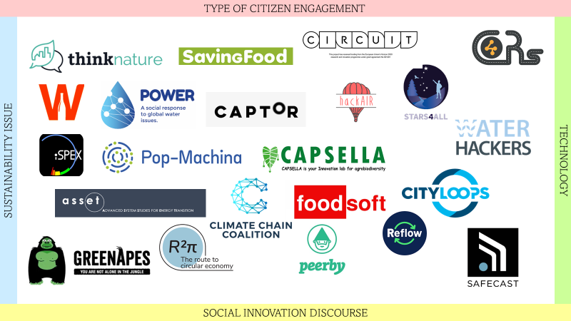
URBAN

Slide 6
Next steps
Collaboration with the company Edgeryders on implementing SSNA (Semantic Social Network Analysis) on their platform to analyse online conversations, in order to map the connections among communities of digital social innovators and explore the discourses, values, and projects related to DSI in urban sustainability
Case study 1 – Turin. Identification of interesting cases of DSI; interviews to policymakers, organisations working on social innovation, digital social innovators, users; participation to related events
Case study 2 – Brussels. Identification of interesting cases of DSI; interviews to policymakers, organisations working on social innovation, digital social innovators, users; participation to related events

Slide 7
Contact Information
Email Address
Samantha.cenere@unito.it

